Slide 1
Navigation information Port of Rotterdam Development of HF radar and 3D Model 2015- 2018
Rinus Schroevers, Martin Verlaan, Firmijn Zijl - Deltares
Mando de Jong, Peter Verburgh - Rijkswaterstaat

Slide 2
Our workspace
Notes:
2
21 november 2011

Slide 3
Delft-FEWS forecasting in over 40 countries
Notes:
Delft-FEWS, het data-integratieplatform van Deltares voor voorspellingen en dagelijks waterbeheer, wordt inmiddels in 41 landen gebruikt (november 2015). Met Delft-FEWS kunnen waterbeheerders tijdig maatregelen nemen waardoor de schade door hoogwater en droogte kan worden beperkt. Gebruikers van Delft-FEWS communiceren sinds een aantal jaar met elkaar via een speciale community portal (www.delft-fews.nl).

Slide 4
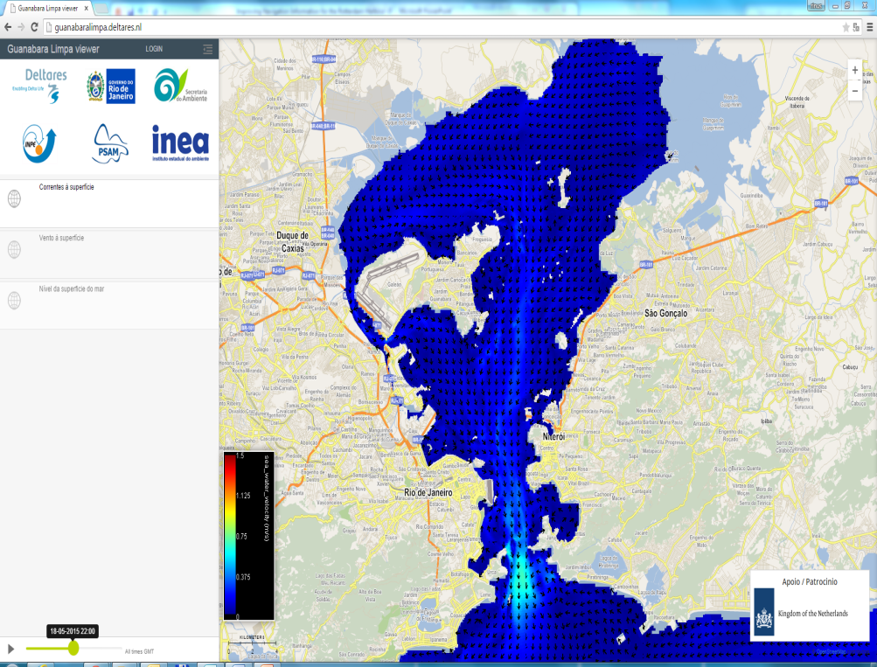
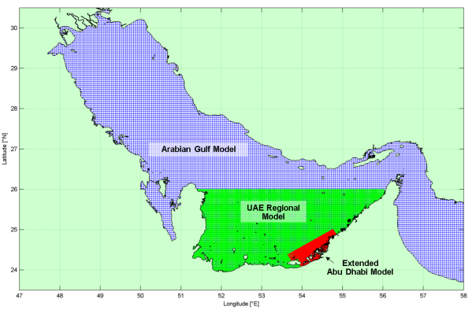
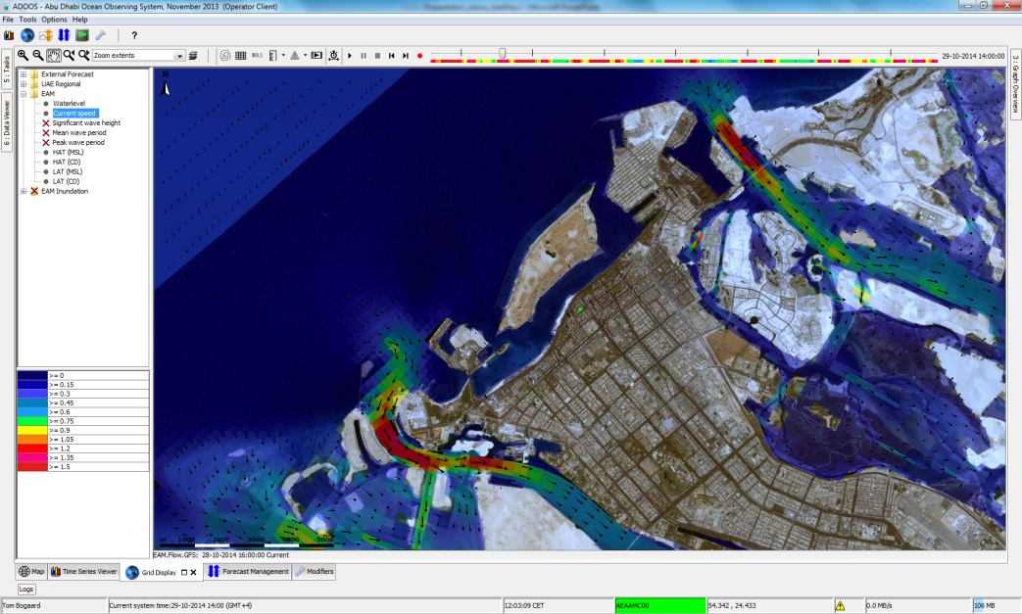
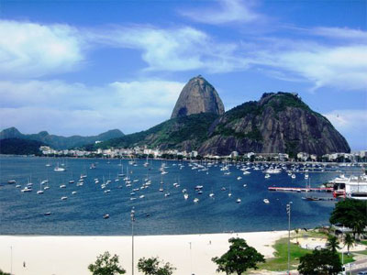
Currents and waves forecasting
Abu Dhabi Ocean Observing System
Classic nested forecasting system
Rio de Janeiro
2016 Olympics
Pre event clean-up
Sailing predictions
Notes:
http://guanabaralimpa.deltares.nl/

Slide 5
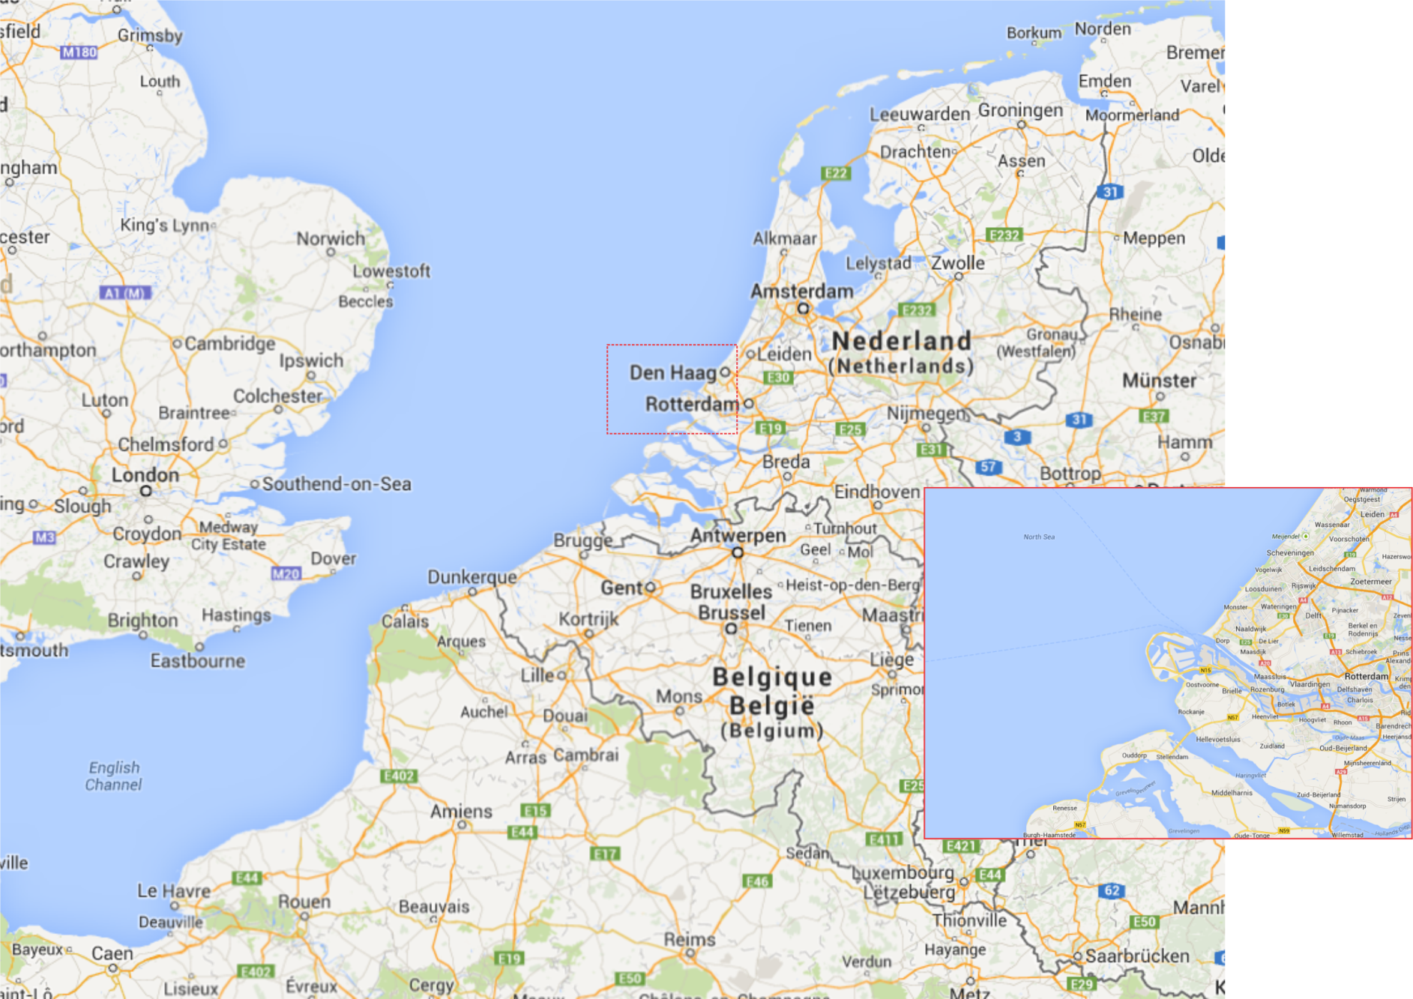
The port of Rotterdam
Rank in Europe | City | Country | TEU's in 2015^{[1]}
1 | Rotterdam | Netherlands | 11,577,000
2 | Antwerp | Belgium | 9,370,000
3 | Hamburg | Germany | 8,848,000
4 | Bremerhaven | Germany | 5,467,000
5 | Valencia | Spain | 4,609,000
6 | Algeciras | Spain | 4,516,000
7 | Felixstowe | United Kingdom | 4,043,000
95.000 movements of sea going vessels p/y
400.000 movements of inland freighters p/y

Slide 6
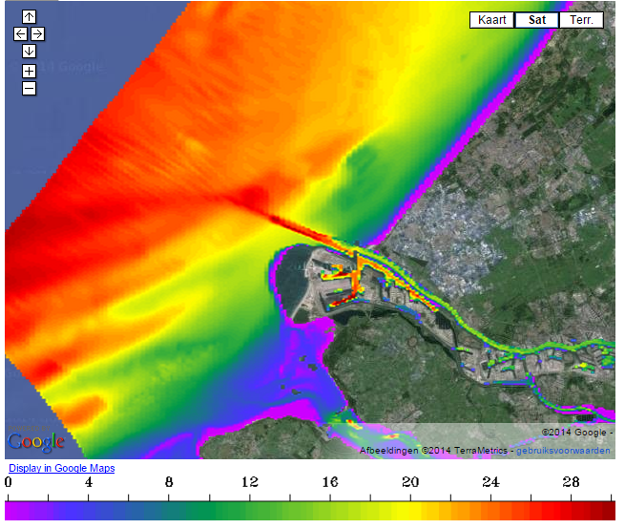
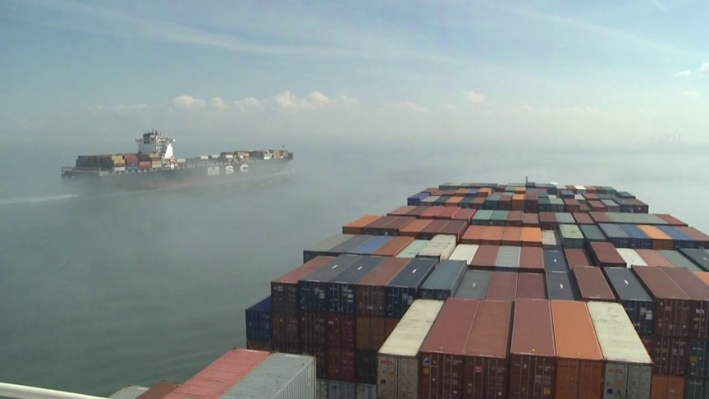
Access to the port Rotterdam: pilots perspective
Euro and Maas channel depth 24 m.
Tide
Swell
Cross currents
Ship specifications
time window

Slide 7
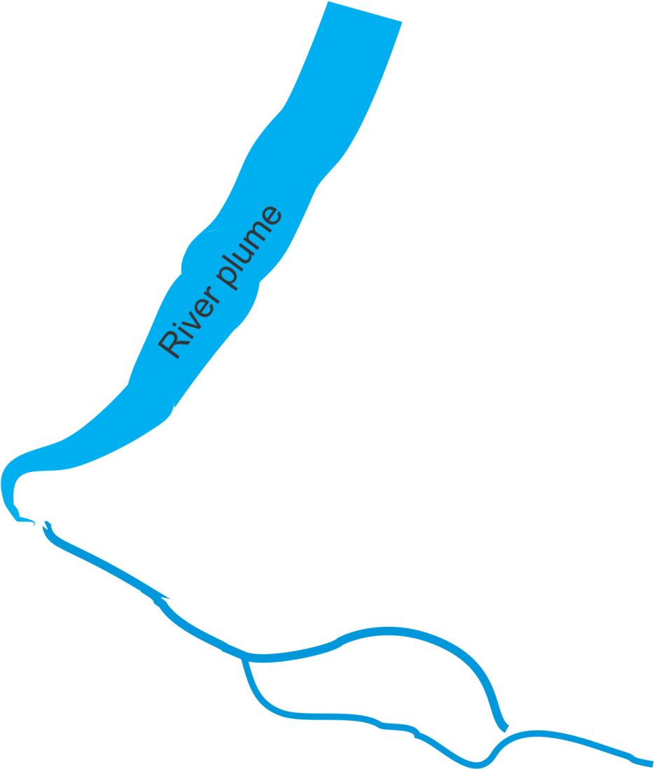
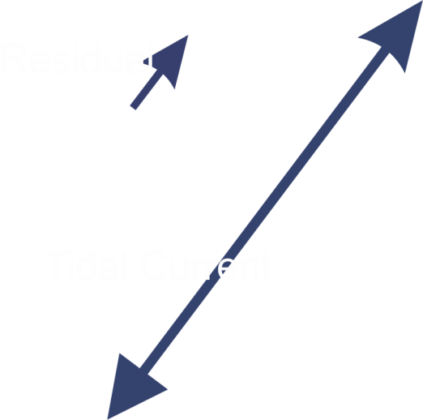
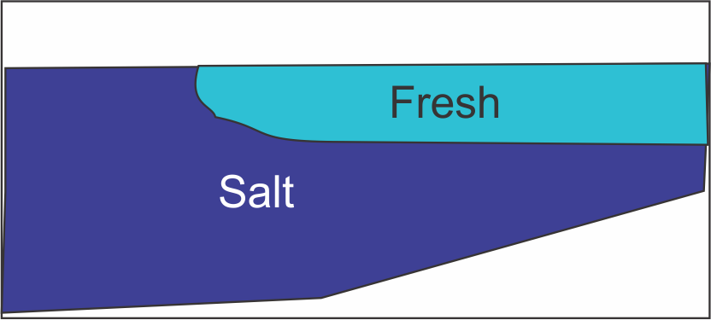
Hydrodynamics at the mouth of river Rhine

Slide 8
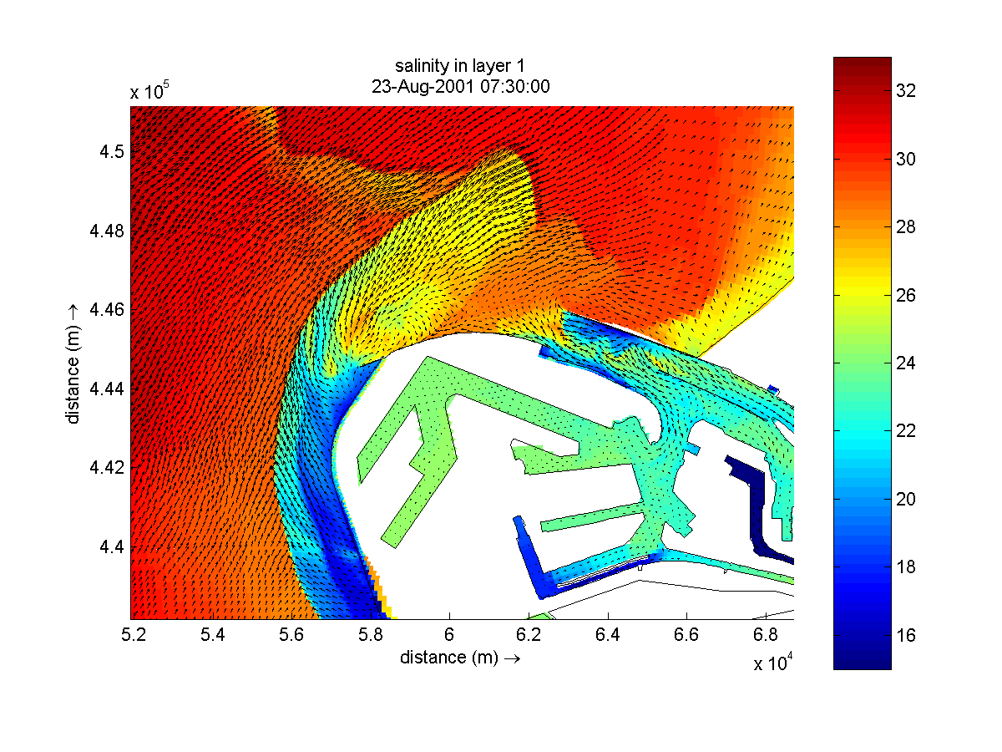
Complex salinity and current structures

Slide 9
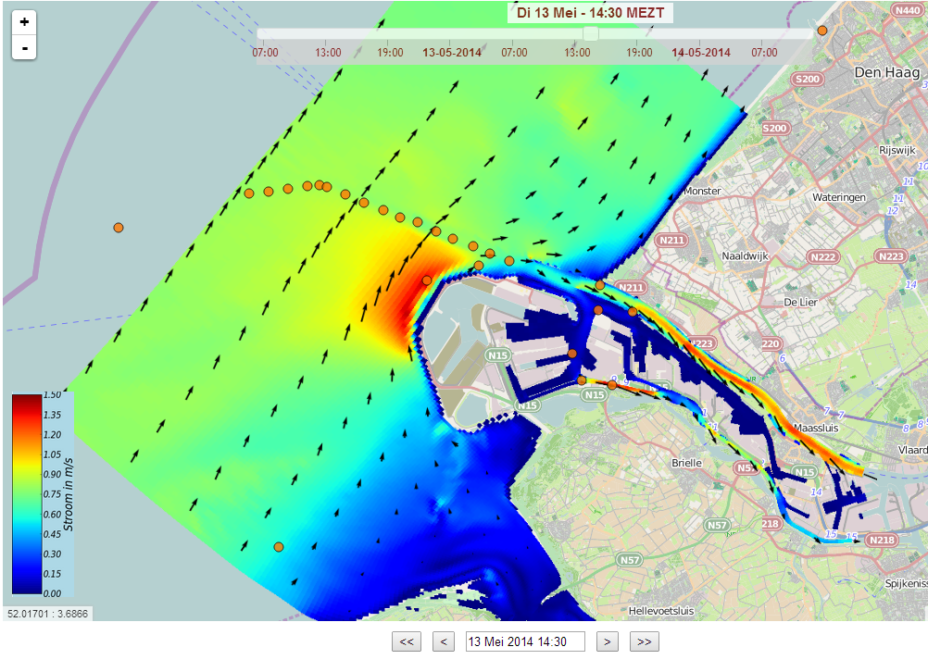
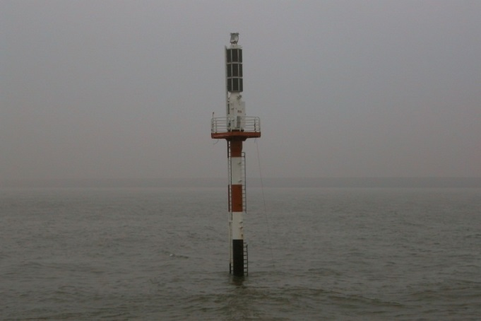
Seaward extension of Port 2011
Pole with ADCP’s
(end of life)
2D hydrodynamic forecast model → depth averaged currents

Slide 10
Proposal 2013: 3D forecast & HF radar
HF radar
Surface currents
Water levels
Assimilation
Initials conditions
3D model
hind cast
3D model
Forecast
3D currents for the whole area

Slide 11
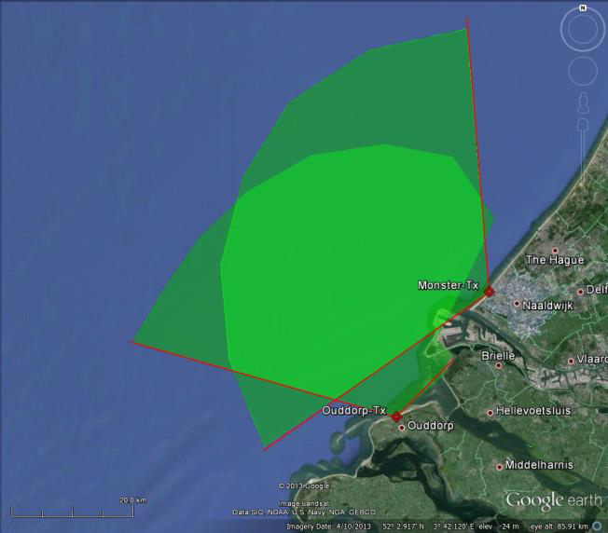
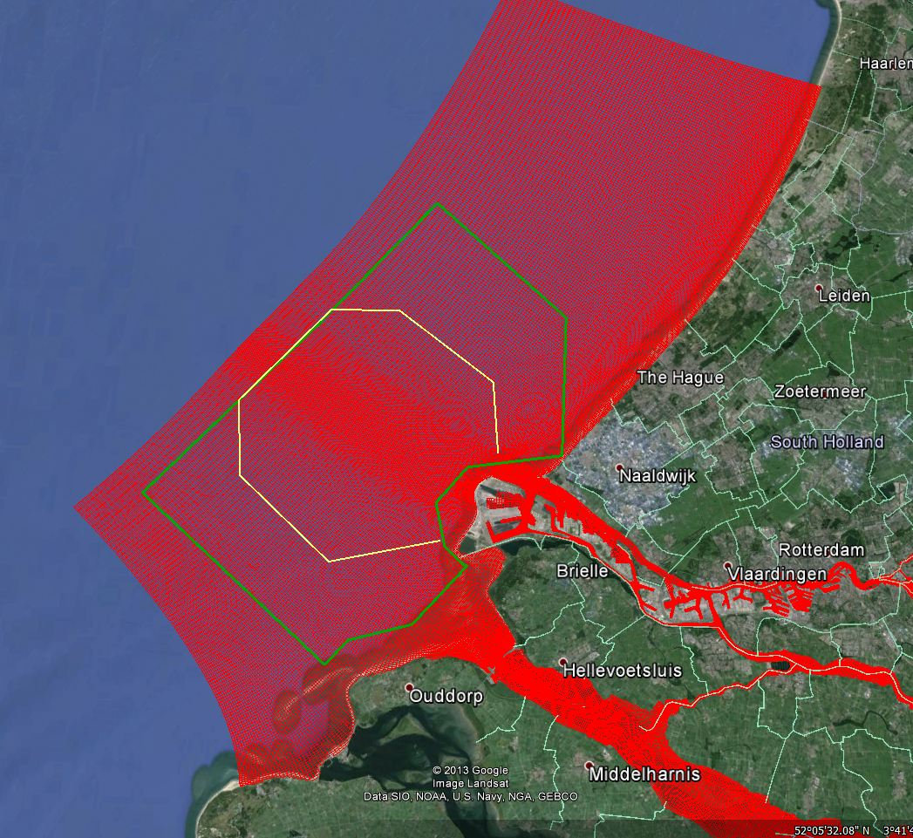
Functional specs HF radar
2 WERA arrays
Area of interest
A: vectors
A+B: radials
Representative depth:
0.7 m
Spatial resolution
around 1 km
Maximum uncertainty
20 cm/s in 30 min.
Data availability
Average 95%
up to Hs 5 m
Time resolution
30 minutes
B
A
B

Slide 12
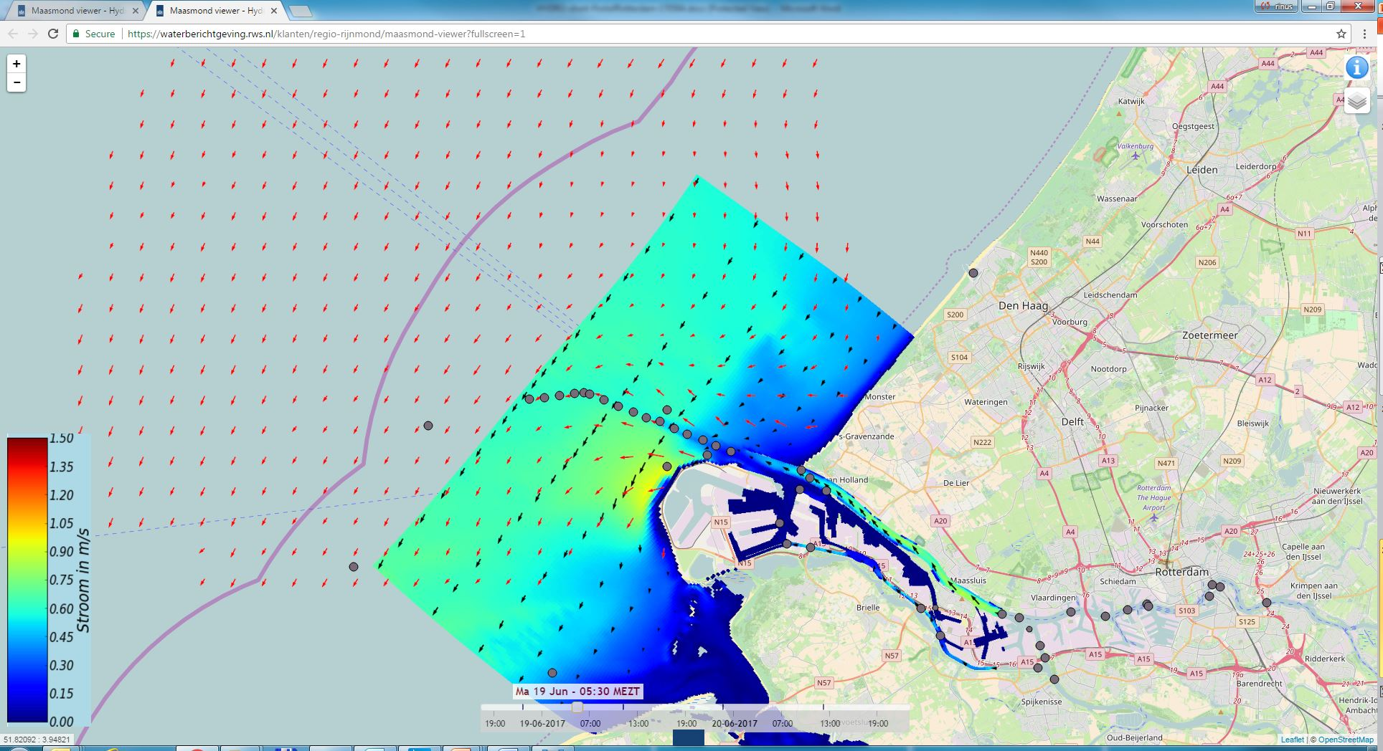
HF radar & 2D model
Notes:
This is on –line infromation for all to see and use

Slide 13
How to validate?
Surface floats → shipping lane
ADCP on bottom or buoy → no surface measurement
Ship based ADCP data → no surface measurement
...
Get creative

Slide 14
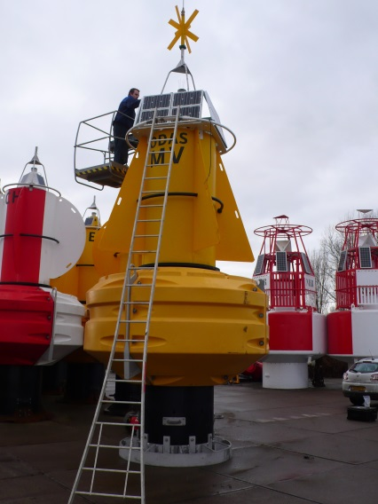
Direct comparisson

Slide 15
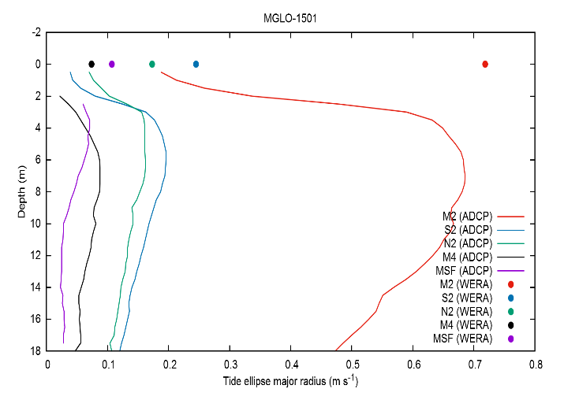
Tidal components analysis, Herron et al. 2016

Slide 16
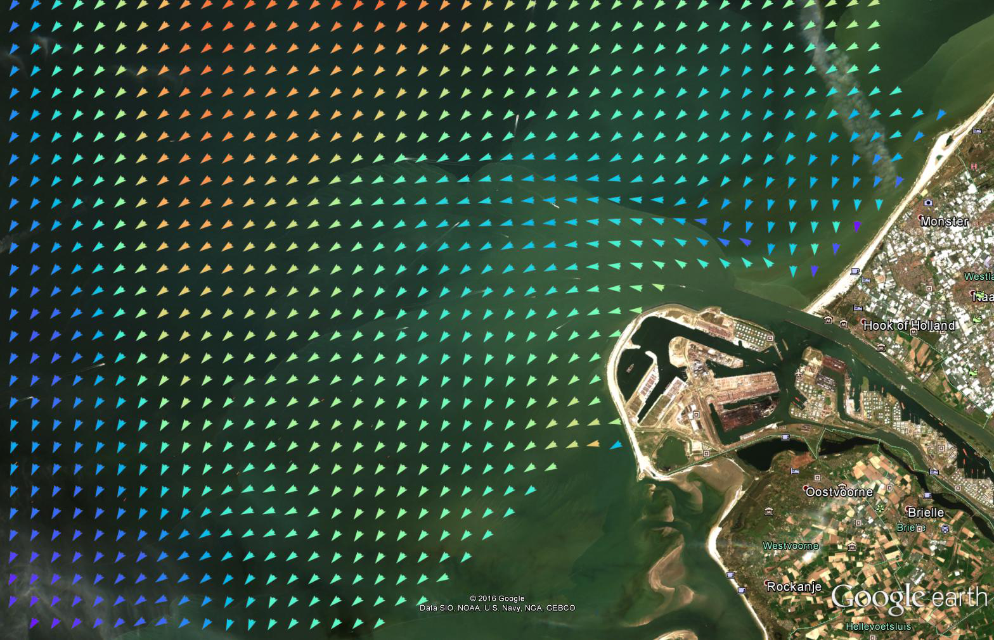
Satellite images

Slide 17
Present status and planning
2013
Proposal for new measurement equipment and 3D model development
2014
Two ADCP buoys installed / HF radar contract awarded
2015
HF radars operational mid 2015
2016
Trials with existing 3D model – not satisfactory
Development new 3D DFLOW FM North Sea model
2017
3D DFLOW FM North Sea model operational
2018
Validation measurments
Start with new 3D DFLOW FM local model
HF radar Data assimilation trials

Slide 18
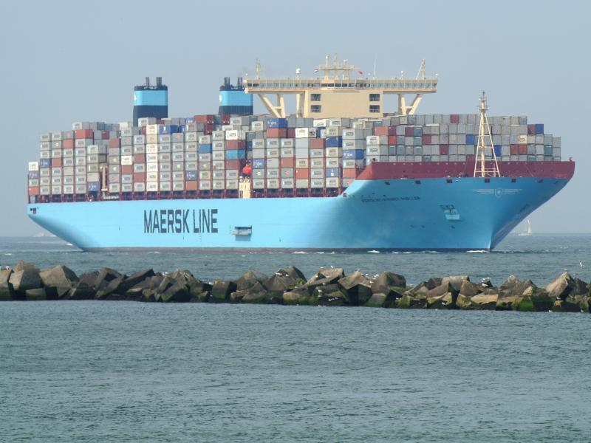
Thank You

